Slide 1



GitHub Actions
Feel free to tweet along with the show: @mickey_gousset
Mickey Gousset
DevOps Architect – GitHub
github.com/mickeygousset
Notes:
Hey y’all!
I’m Mickey Gousset, a DevOps Architect with the GitHub FastTrack team. In my day job, I go out and help people get more “dev-opsy” with GitHub, and I am thrilled to be here today to talk to you about Getting Started with GitHub Actions. Feel free to mention me on Twitter and tweet out comments or reactions during the presentation.
My assumptions about the audience are:
- You know nothing, or very little about GitHub Actions
Therefore, I’m going to be starting with the basics, but don’t worry, for those of you that do have some GitHub Actions knowledge, I have a real world demo, complete with pull request and deployment automation, as well as slack integration. So there is something for everyone. I also have another talk I give, called Advanced GitHub Actions, where I dive deep into more advanced topics.

Slide 2
Before we begin…..
GitHub mobile app:
https://github.com/mobile/
Navigate to this repo
https://github.com/mickeygoussetorg/github-actions-presentation
Notes:
Now before we get started, I want to warn you ahead of time that my final demo is an audience participation demo. In order to participate, you’ll need to be able to access my repo, which I have listed on the screen. Don’t worry, I’ll show it again.
I’d encourage you to download the GitHub mobile app and use it, but you can also use a web browser on any device. The GitHub mobile app, if you haven’t used it, is a great way to interact with the different aspects of GitHub, directly from your phone. I tend to use it daily.

Slide 3
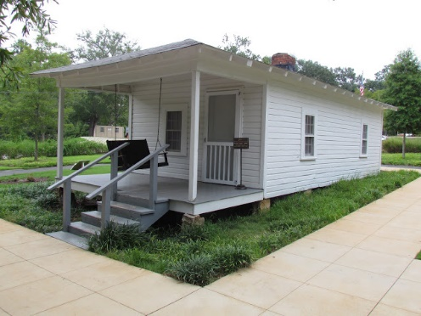
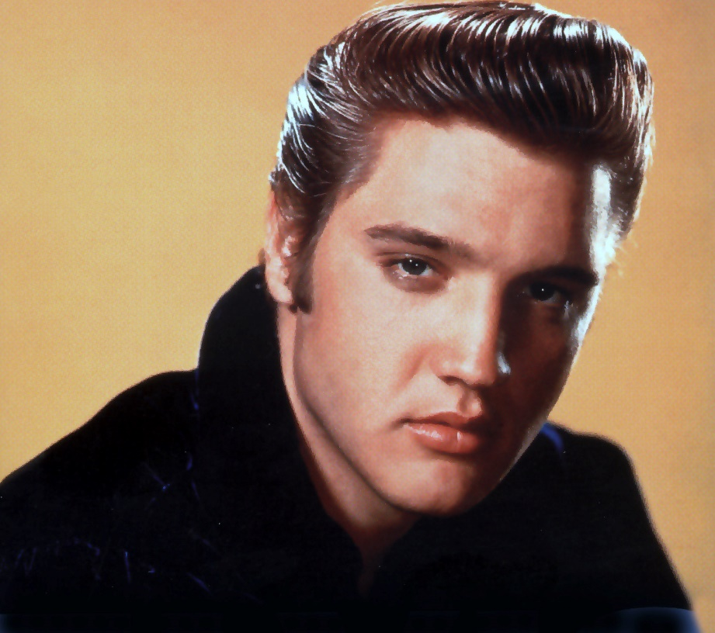

What is Tupelo, MS world-famous for?
Notes:
What is Tupelo, MS world famous for?

Slide 4









































GitHub is the largest developer platform on Earth
65M+
200M+
1,000s
1B+
3M+
72%
Developers
Private and public
repositories
Top open source
communities
Contributions
per year
Organizations
Fortune 500
companies
The most innovative companies
The top open source projects
Leading global enterprises
Largest DevOps ecosystem
Notes:
Don’t know who GitHub is? We are the largest developer platform on Earth. We have built our platform through our experience with millions of developers, thousands of open source communities, thousands of enterprise customers, and hundreds of ISV ecosystem partners. We support all developers from the individual maintainer with free public and private repos at GitHub.com and up to thousands of developers via GitHub Enterprise which is available in both a cloud and server model.

Slide 5
What is DevOps
Develop
DevOps is the union of people, process, and products to enable continuous delivery of value to your end users.
DevOps
Operate
Deliver

Slide 6
What are GitHub Actions?
#1
CI on GitHub
10,000+
Actions in GitHub Marketplace
Custom workflows triggered on any GitHub event
Not just for CI/CD
Workflows stored as yml files
Live logs and visualized workflow execution
Community powered workflows
Linux, macOS, and Windows hosted runners
Self hosted runners
Built-in secret store
GitHub Enterprise Server support
Any platform, any language, any cloud
Events
Trigger
Workflows
Use
Actions

Slide 7
Why GitHub Actions is(are?) Important To You – Some Stats
Open Source projects using GitHub Actions merged 34% more pull requests
Open Source projects using GitHub Actions decreased time to merge by 18%
Notes:
Open source communicites also leverage the value of automation. Automation accelerates software delivery by helping teams automate their workflow, leaving more tiem to focus on the most critical work. Open soruce projects that use GitHub Actions to automate their pull requests saw faster software delivery and better collaboration

Slide 8
Terminology
Notes:
Let’s discuss some basic terminology, to level set the field, before we start looking at demos

Slide 9

Key Components
SECRETS
Workflow
Job 1
Runner 1
Step 1
Action
Run Action
Events
Log Results
Step 2
Action
Job 2
Runner 2
Step 1
Action
Run Action
Environments
Log Results
Step 2
Action

Slide 10


Runners
Runners
GitHub-hosted runner
Self-hosted runner
https://github.com/actions/runner

Slide 11
Quick summary
Events
Events trigger workflows, e.g. a push to a branch
Workflows contain one or more jobs, which contains one or more steps
These steps can reference actions or execute commands
The term “GitHub Actions” include all components, not just the Actions themselves
trigger
Workflows
reference
Actions

Slide 12
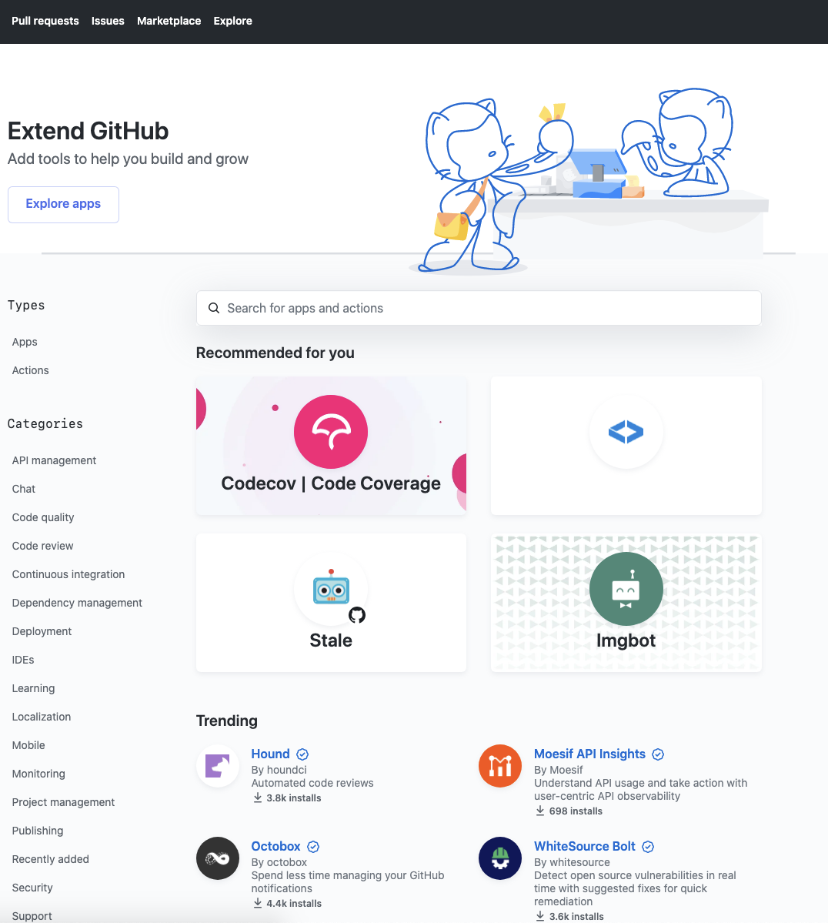

GitHub Marketplace
Discover open-source Actions across multiple domains
> 10,000 Actions (and counting)
Verified creators
Reference these Actions directly in your workflow
Integrated into the GitHub editor

Slide 13
Writing your own Actions
./path/to/action/action.yml
name: “Hello Action”
description: “Greet someone”
author: “octocat@github.com”
inputs:
MY_NAME:
description: “Who to greet”
required: true
default: “World”
outputs:
GREETING:
description: “Full greeting”
runs:
using: “docker”
image: “Dockerfile”
branding:
icon: “mic”
color: “purple”
3 types of Actions
JavaScript
Docker
Composite
Metadata defined in action.yml file
Inputs
Outputs
Branding
Pre/Post Scripts

Slide 14
That’s enough to get us started…
Demos
Basic workflow
Chaining Jobs
Variables
Notes:
Basic workflow
Bare minimum for workflow
Workflow templates
YAML editor
Workflow Logs
Parameters
Chaining Jobs
Parallel pipelines
Controlling pipeline order/flow
Conditional statements to control when jobs run
Variables
GitHub Context Object
Job/Step output variables
Environment variables

Slide 15
Ok, let’s do this for reals…
.NET Core MVC App
On PR, will execute build/test to verify clean code
On Push to Main:
Build app
Deploy to DEV and QA at the same time
Manual approval to PROD
Notes:
Other things we show in this demo
PR workflow publishes test results as job summary
Branch protection rule that requires PR to pass
Using OIDC to create connection to Azure
Concurrency to ensure only one deployment is running at a time
Re-running failed jobs
Skip ci keyword to make a change and not trigger workflow

Slide 16
Now let’s have a little fun….
Remember:
https://github.com/mickeygoussetorg/github-actions-presentation
Go star the repo and let’s see what happens

Slide 17
Resources
https://github.com/sdras/awesome-actions
https://docs.github.com/en/actions/reference
https://github.com/mobile/
https://elvispresleybirthplace.com/
Notes:
Universe
Octoreport
Mobile app
Link to Elvis’s birthplace

Slide 18

Q&A
Mickey Gousset
https://github.com/mickeygousset
https://mickeygousset.com
https://youtube.com/mickeygousset
https://twitch.tv/mickeygousset
Twitter: @mickey_gousset
Email: mickeygousset@github.com

